Slide 1

Riding the Data:
An Analysis of NYC’s Taxi Economy
A Presentation by Hesham Mushtaq

Slide 2
Dataset Overview
Source: Kaggle (anandshaw2001/taxi-dataset)
Time period: January-February 2020
Size: 11.9 million trips
Key fields: pickup/dropoff times & locations, fares, payment types, distances
Why this matters: With Uber, Lyft, and Citi Bike disrupting urban transportation, traditional taxis must leverage data to compete. Our analysis reveals strategic opportunities for taxis to optimize routes, pricing, and service hours to reclaim market share in NYC's gig economy.

Slide 3
Dataset Overview
month | ride_count
January | 6405027
February | 5485369
March | 12
April | 4
May | 9
June | 1
July | 26049
total_rows
11916662
year | ride_count
2003 | 1
2008 | 16
2009 | 40
2019 | 131
2020 | 11916471
2021 | 3

Slide 4
Wrangling
Tools: DuckDB for large-scale processing (1.08 GB dataset!!)
Filtering: Extracted Jan-Feb 2020 trips only
Quality checks: Removed records with missing critical fields (VendorID, pickup/dropoff times, fare amounts)
Enrichment: Merged with NYC Taxi Zone Lookup to add borough and zone names
Result: Clean, enriched dataset ready for dimensional modeling

Slide 5
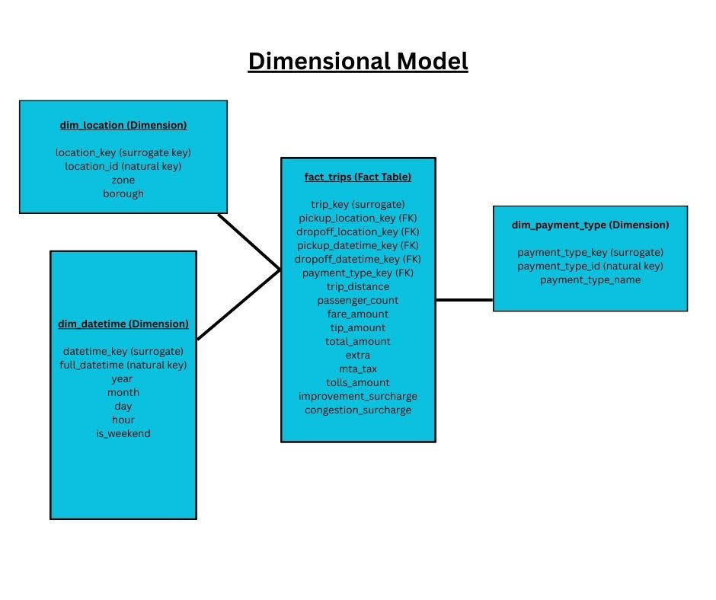
Star Schema Design
Architecture: Star schema with 1 fact table + 3 dimension tables
Fact Table (fact_trips):
Grain: One row per taxi trip
Measures: trip_distance, passenger_count, fare_amount, tip_amount, total_amount, extra, Mta_tax, Tolls_amount, Improvement_surcharge, congestion_surcharge
Dimension Tables:
dim_location (265 zones)
dim_datetime (unique timestamps)
dim_payment_type (6 types)
Notes:
Insert schema design here

Slide 6
Why Not Two Location Dimensions? (Pickup vs Drop Off)
Design Choice: One Location Dimension
Both pickup and dropoff reference the same dim_location
Avoids duplicate dimensions with identical attributes
Enables geographic comparisons (pickup vs dropoff)
Reduces storage and simplifies ETL
What Analysis Does This Model Support?
Revenue trends by hour/day/month
Location-based demand patterns
Airport vs. city demand quality
Tip behavior by payment type
Fee impact on profitability
Peak vs. off-peak trip characteristics

Slide 7
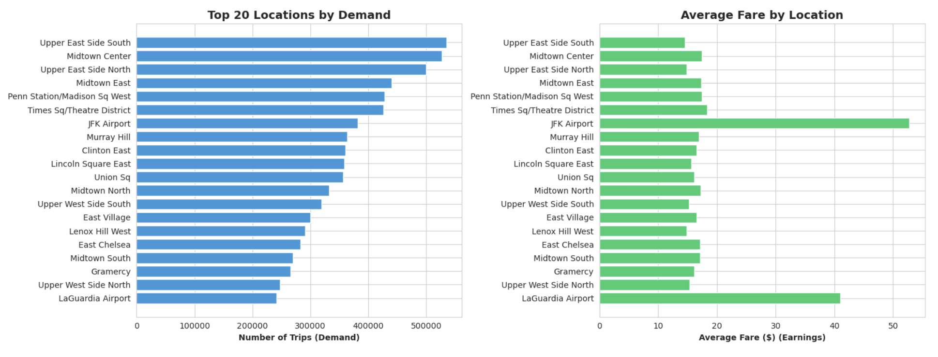
Question: Best Locations for Demand & Earnings
High demand: Upper East Side South, Midtown Center (500K+ trips)
High earnings: JFK Airport ($53 avg fare)
Sweet spot: Manhattan core zones combine both
Notes:
Insert schema design here

Slide 8
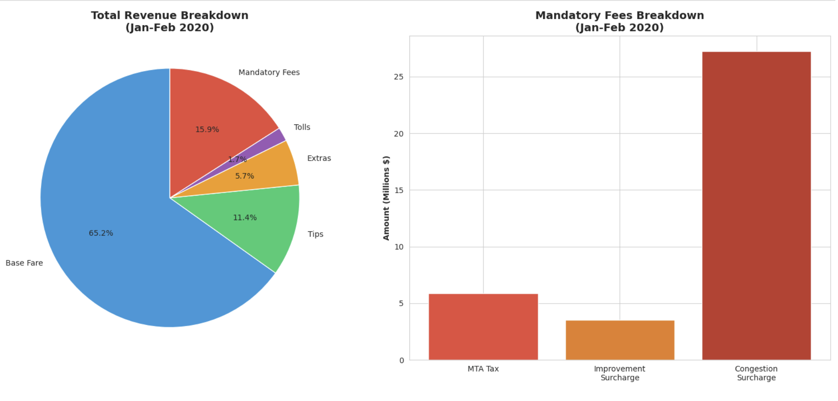
Question: Revenue Lost to Mandatory Fees
Mandatory fees: 15.9% of total revenue
Congestion surcharge: Largest component
Impact: Significant revenue never reaches drivers

Slide 9

Key Insights for NYC Taxi Operations
Location strategy: Focus on Manhattan core for balanced demand and earnings
Payment preference: Credit cards provide transparent, higher recorded tips
Fee awareness: 16% of revenue goes to mandatory fees, impacting driver income
Timing optimization: Night and afternoon shifts maximize profitability
Future work: Analyze seasonal patterns, COVID impact, competition from rideshares

